Slide 1
EXPLORING ORGANISATIONAL APPROACHES TO INTERNATIONAL MARKET ENTRY UNDER GLOBAL ECONOMY
Student Name: Rama Koteswara Rao Mangineni
Student ID: S24013995

Slide 2
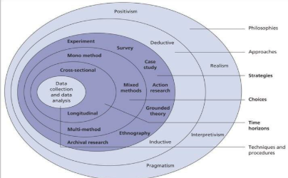
RESEARCH DESIGN AND METHODOLOGICAL CHOICES
The chapter outlines the methodological choices undertaken in investigating how internationally operated firms embraces effective market entry strategies amid global economic uncertainties
Philosophy- Positivism philosophy (Maretha, 2023)
Approach- Deductive approach (Kumar and Ujire, 2024)
Design- Descriptive design (Younas et al., 2023)
Methodological choice- Quantitative
Notes:
The slide displays methodological choices regarding research design and methodological choices. In this context, the rationale behind considering positivism philosophy involves ensuring evidence based evaluation regarding how internationally operated firm’s response to global economic uncertainty. On the other hand, the researcher further has considered implementing deductive approach to test existing theoretical assumptions regarding the study context.

Slide 3
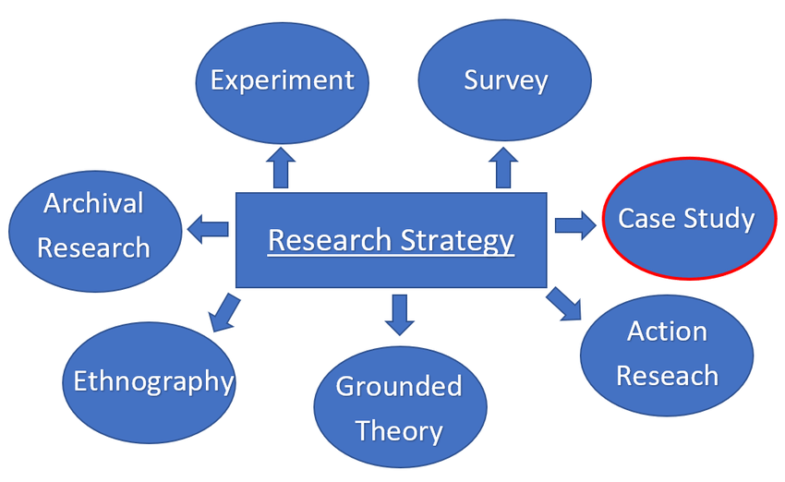
RESEARCH STRATEGY, RESEARCH POPULATION, TIME HORIZON AND DATA COLLECTION PROCESS
Data collection process- Primary Quantitative (Steleżuk and Wolanin, 2023)
Time horizon- Cross-sectional (Hunziker and Blankenagel, 2024)
Research strategy- Survey/ Questionnaires (Ghanad, 2023)
Population- 100 individuals who are responsible for executing strategic roles or decision-making across internationally operated firms
Notes:
The chapter showcases research strategy, population, data collection process and time horizon selected to deduce the study findings. In this context, the rationale behind considering survey strategy involves its competencies on utilising structured questionnaires in collecting quantifiable data on market entry strategies used by firms to tackle global economic uncertainty. As for the choice of data collection instruments the researcher utilises 15 closed-ended questionnaires, Likert Scale, Microsoft form, Microsoft Excel and word. These are to record survey responses from real-time responses and develop a complex data set for analysis process.

Slide 4
DATA ANALYSIS, AND ETHICAL CONSIDERATION
Data Analysis- SPSS as preferable statistical tools (Rahman and Muktadir, 2021)
Apart from this to display the researchable data the researcher further has considered carrying out Correlation test, t-Test, Anova, regression analysis and descriptive statistics as preferable choices (Rahayu et al., 2024)
SPSS
Correlation test
t-Test
Anova
Regression analysis
Descriptive statistics
Notes:
The slide presents the analytical tools considered by the researcher in analysing, evaluating and interpreting the researchable data sets. During carrying out the data collection it has been make sure that the process is fully complied with GDPR (General data protection regulations) and Data protection Act 2018. These are to ensure legal compliance and safeguard personal information during handling the researchable data. The chapter plays a significant role towards providing a systematic, ethical and reliable framework to generate valid insights.

Slide 5
REFERENCES
Ghanad, A., 2023. An overview of quantitative research methods. International journal of multidisciplinary research and analysis, 6(08), pp.3794-3803.
Hunziker, S. and Blankenagel, M., 2024. Cross-sectional research design. In Research design in business and management: A practical guide for students and researchers (pp. 187-199). Wiesbaden: Springer Fachmedien Wiesbaden.
Kumar, S. and Ujire, D.K., 2024. Inductive and deductive approaches to qualitative research. International Journal of Multidisciplinary Educational Research, 13(1), pp.58-63.
Maretha, C., 2023. Positivism in philosophical studies. Journal of Innovation in Teaching and Instructional Media, 3(3), pp.124-138.
Rahayu, N.I., Muktiarni, M. and Hidayat, Y., 2024. An application of statistical testing: A guide to basic parametric statistics in educational research using SPSS. ASEAN Journal of Science and Engineering, 4(3), pp.569-582.
Rahman, A. and Muktadir, M.G., 2021. SPSS: An imperative quantitative data analysis tool for social science research. International Journal of Research and Innovation in Social Science, 5(10), pp.300-302.
Steleżuk, A. and Wolanin, M., 2023. Primary research using quantitative methods in social sciences. Zeszyty Naukowe Wyższej Szkoły Technicznej w Katowicach, 16.
Younas, A., Fàbregues, S., Durante, A., Escalante, E.L., Inayat, S. and Ali, P., 2023. Proposing the “MIRACLE” narrative framework for providing thick description in qualitative research. International Journal of Qualitative Methods, 22, p.16094069221147162.
Notes:
Ghanad, A., 2023. An overview of quantitative research methods. International journal of multidisciplinary research and analysis, 6(08), pp.3794-3803.
Hunziker, S. and Blankenagel, M., 2024. Cross-sectional research design. In Research design in business and management: A practical guide for students and researchers (pp. 187-199). Wiesbaden: Springer Fachmedien Wiesbaden.
Kumar, S. and Ujire, D.K., 2024. Inductive and deductive approaches to qualitative research. International Journal of Multidisciplinary Educational Research, 13(1), pp.58-63.
Maretha, C., 2023. Positivism in philosophical studies. Journal of Innovation in Teaching and Instructional Media, 3(3), pp.124-138.
Rahayu, N.I., Muktiarni, M. and Hidayat, Y., 2024. An application of statistical testing: A guide to basic parametric statistics in educational research using SPSS. ASEAN Journal of Science and Engineering, 4(3), pp.569-582.
Rahman, A. and Muktadir, M.G., 2021. SPSS: An imperative quantitative data analysis tool for social science research. International Journal of Research and Innovation in Social Science, 5(10), pp.300-302.
Steleżuk, A. and Wolanin, M., 2023. Primary research using quantitative methods in social sciences. Zeszyty Naukowe Wyższej Szkoły Technicznej w Katowicach, 16.
Younas, A., Fàbregues, S., Durante, A., Escalante, E.L., Inayat, S. and Ali, P., 2023. Proposing the “MIRACLE” narrative framework for providing thick description in qualitative research. International Journal of Qualitative Methods, 22, p.16094069221147162.

